Slide 1

Mary Kate Allen,Amra Kursumlija, Lexi Couwenberg, & Stefania Cosma

Slide 2

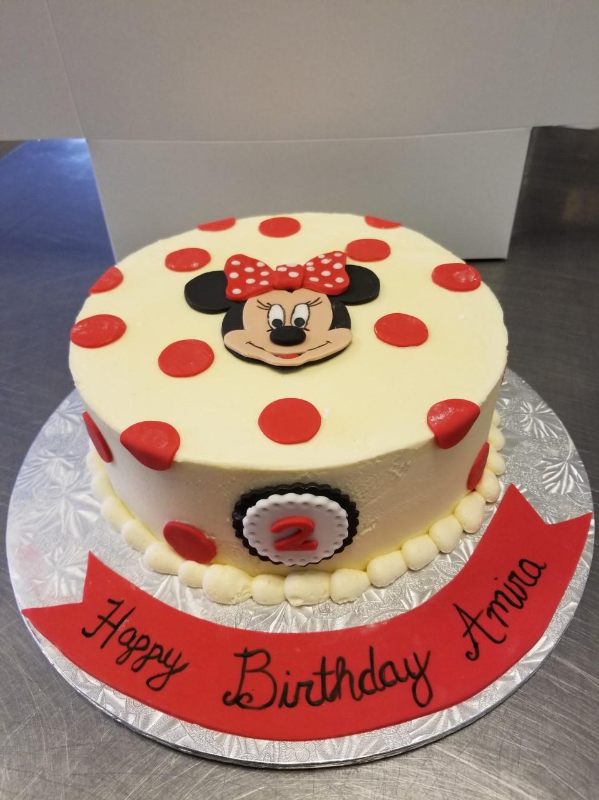

A bakery located in Guelph, Ontario
7 years old
Specializes in cupcakes, custom cakes, and other deserts
Has 4-5 full time employees
144 cupcake flavours

Slide 3
Initial Problem: HR, Inventory Control, Marketing, Social Media, Order flow & SEO.
Additional Problems: Time Clock Applications & Recruiting issues.
What we chose to tackle: Automated workflow, Manual workflow, Social Media, Time Clock Applications, & Recruiting.

Slide 4
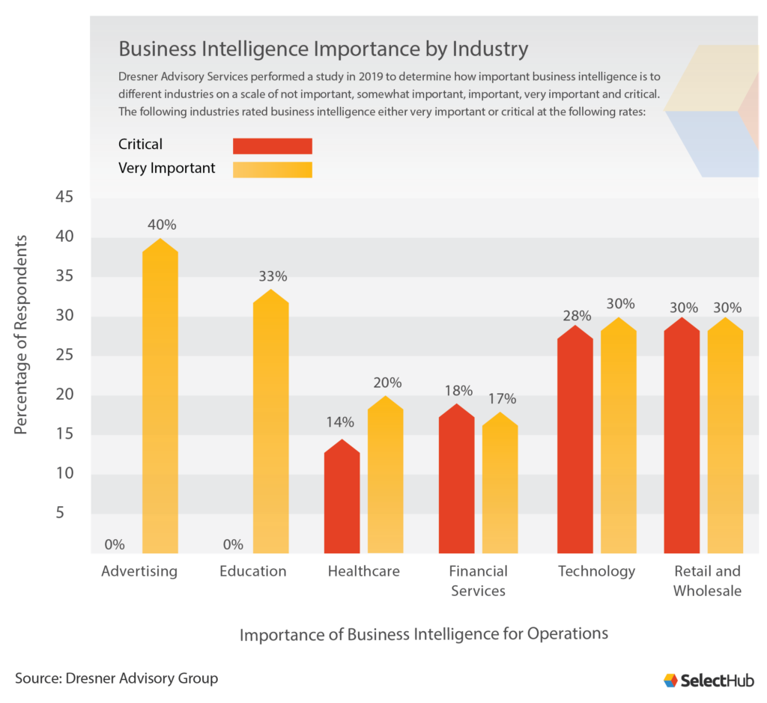
Automated/Business Management System
Business Intelligence System
Importance increasing yearly- by 2022 BI global revenue raise to $29.48 Billion compared to $22.8 Billion in 2020
Retail sector
BI becoming increasingly important to the retail sector
Accurate reporting
Better business decisions
Improve operational efficiency
58% consider it as either “critical” or “very important”

Slide 5
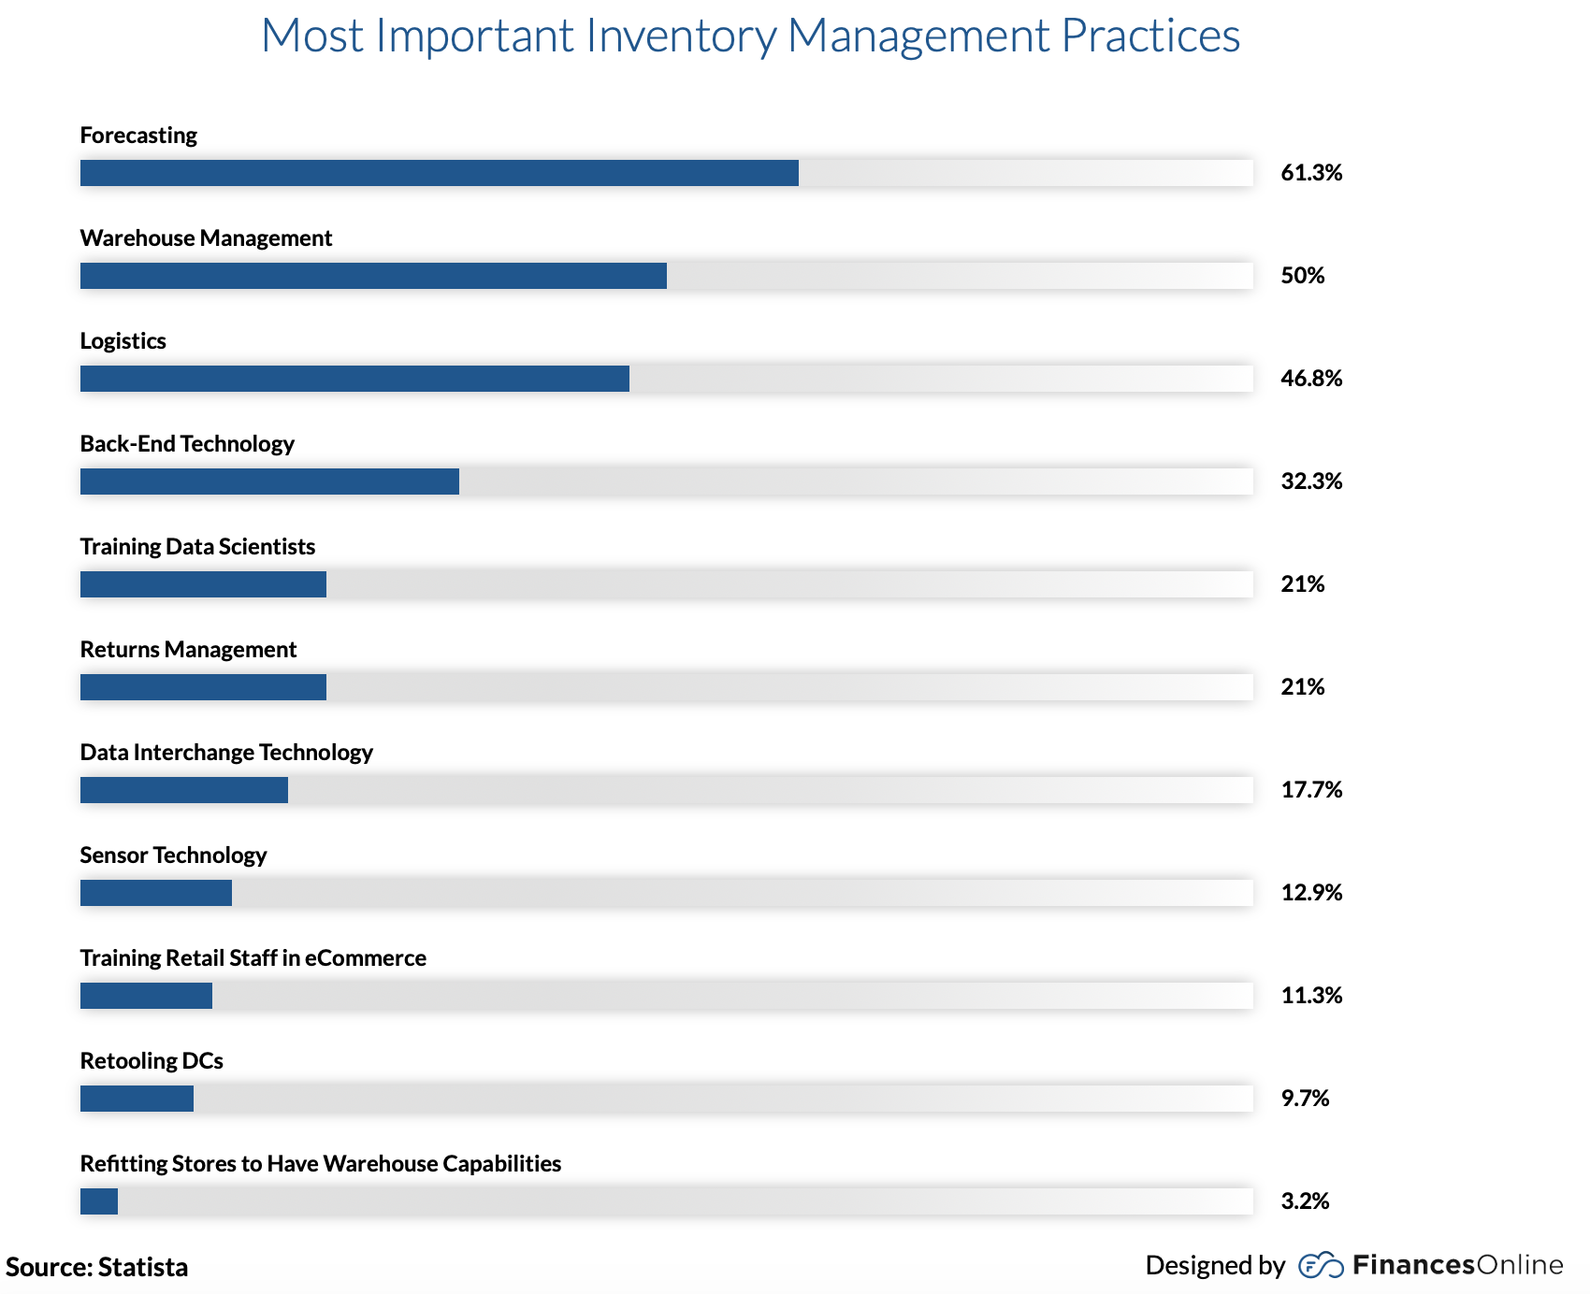
Inventory Management Software
IMS Statistics
Retailers/wholesalers enjoy a 25% increase in overall productivity
56% of small businesses utilize inventory control software
Importance: Forecasting
IMS tracks past sales and predicts future stock level ( decreases manual labour, stock counting etc.)

Slide 6
Research -Automated Inventory Systems
Criteria | Weight | Twin Peaks | Flexibake | Cakeboss | Baking It
Customizable | 35% | 5 = 1.75 | 5 = 1.75 | 4 = 1.4 | 5 = 1.75
Cost | 20% | 3 = 0.6 | 2 = 0.4 | 4 = 0.8 | 5 = 1.0
Ease of Use (Simplicity) | 25% | 4 = 1.0 | 3.5 = 0.88 | 4 = 1.0 | 4 = 1.0
Accessibility (who can use it) | 20% | 4.5 = 0.9 | 4 = 0.8 | 3 = 0.6 | 4.5 = 0.9
Totals |  | 4.25 | 3.83 | 3.8 | 4.65
1 - being the worst option & 5 - being the best option

Slide 7

Baking It
Manages
Inventory
Supplies
Equipment
Features
Calculate and cost recipes
US & Canadian measurements & currencies
Input customer, supplier, vendor info
Tasks & Expenses
Quotes & Orders
Order profit, tax, discounts
PDFs
Business Analytics
Calendar Home page (shows upcoming events/orders)
Cost
$299 For one time payment, than $29.99/month (Cloud storage fee)

Slide 8
Research - Manual
Taking information from automated systems, we decided to create an easy to use excel program that will eliminate the paper filing system
This would avoid the high costs, and complexity of automated systems
  This program also allows Decadently Yours to ease into the automated world
While we wanted to make an excel program that provided a system that would track inventory automatically, we were unable to with the information the client was willing to give
What we were able to provide is a program that would allow for order inputs, scheduling, file maintenance and inventory management

Slide 9
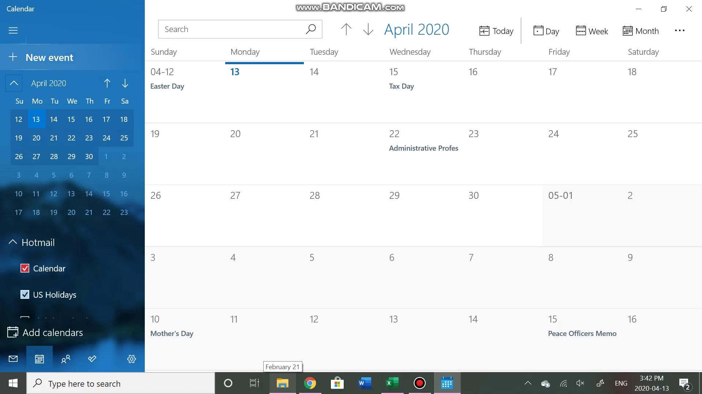
Manual Working Systems

Slide 10
Social Media Trends
General Trends
People between ages 16-24 spend closer to 3 hours / day on social media
Platform changes
Users don’t see every post. Posts are based off Platform Algorithm which can change or update
Algorithm
A way for platforms to sort a users posts (what they see) based off their platform usage
Instagram Algorithm 3 Factors
Relationship with user
Expressed Interests
Recency of Posts
Facebook Algorithm
“Meaningful Interactions”
“Why am I seeing this?”- more user control
Facebook ranking scale
Who interacts with user
Type of media post
Post popularity

Slide 11

Pinterest
Benefits
Pinterest is the only visual search engine
63% of GenZers and millennials would like the option to search by images
Increase foot traffic
What it is:
Information discovery tool
Either for business or users
Create as many boards with “pins” (images with links to recipes, websites, etc..)
Statistics:
2019 Pinterest users increased to 335 million (4th used platform in canada)
80% of women between the ages of 18-64 are on Pinterest

Slide 12

Hootsuite
Benefits
All-in-one scheduling
Monitoring
Platform analytics monitoring
Content Calendar
Auto schedule to schedule already created media (images or videos with captions)
Alerts through phone
Posting Stats
Facebook: 8 to 15 times/ week
Instagram: 5 to 10 times
Great for small business
Lack of time or manual labour
Cost
$29.99/month for Professional
1 user
10 social media accounts
Unlimited scheduling

Slide 13
Research - Time Clock Applications
Criteria | Weight | On the Clock | Easy Clocking | Time Clock Sync
Cost | (20%) | 4 = 0.8 $2.20/employee 15 employees - $36.75/month | 0.0 Unable to receive a quote. | 5 = 1.0 $9.99 base fee per month. 5 employees - $0/month 6-99 employees - $2.49/month per employee
Features | (30%) | 5 = 1.5 Cancel anytime - No contract - No Base Monthly Fee - Free Support - Free Phone App - Payroll & Project Reporting - Mobile & Online | 5 = 1.5 - Clock In/Out - View Schedules - Approve Time Card - View Employee Time Cards - Request Time off - Clocking with GPS Tracking - Export Payroll | 5 = 1.5 - Cancel anytime - Unlimited devices - Real time tracking - Instant reports
Availability - android/iphone | (25%) | 5 = 1.25 Anywhere with the internet/data, on every device. | 5 = 1.25 Anywhere with the internet/data, on every device. | 5 = 1.25 Anywhere with the internet/data, on every device.
Easy to use | (25%) | 5 = 1.25 Based on Free Trial, Very Easy to Use. | 5 = 1.25 Based on the demo, easy to use. | 5 = 1.25 Based on the tutorial, easy to use.
Totals |  | 4.8 | 4 | 5
1 - being the worst option & 5 - being the best option

Slide 14
Additional Research - Time Clocks Applications
→ On The Clock, not the right choice
→ Researches a 4th option
→ Must have location tracking options
→ ATTO Team Activity
Features | ATTO Team Activity
Cost | $5 per user/month or $48 per user/year
Features | Help center link on the app Employer can clock employees out if need to Shared location can be a requirement for employees to clock in Access to clock in location and time Employer has to invite employees (send a link to the email address) PTO can be submitted through the app 15 days free trial
Availability - Android/iphone | ATTO Team Activity app available for both android and iphone download for $0 dollars
Easy to use | Few and simple features, with minimal customizable options Easy to learn and get used to

Slide 15

Time Clock Applications
How does it work?
→ Account manager adds employee’s email
→ Employee receives an email with a request to register - create an account
→ account manager can add location as a feature
→ employee must agree to share location to create an account
→ employees can submit PTO through the app
ATTO: Team Activity
→ Easy to use
→ Inexpensive
→ Location services

Slide 16








Recruiting

Slide 17
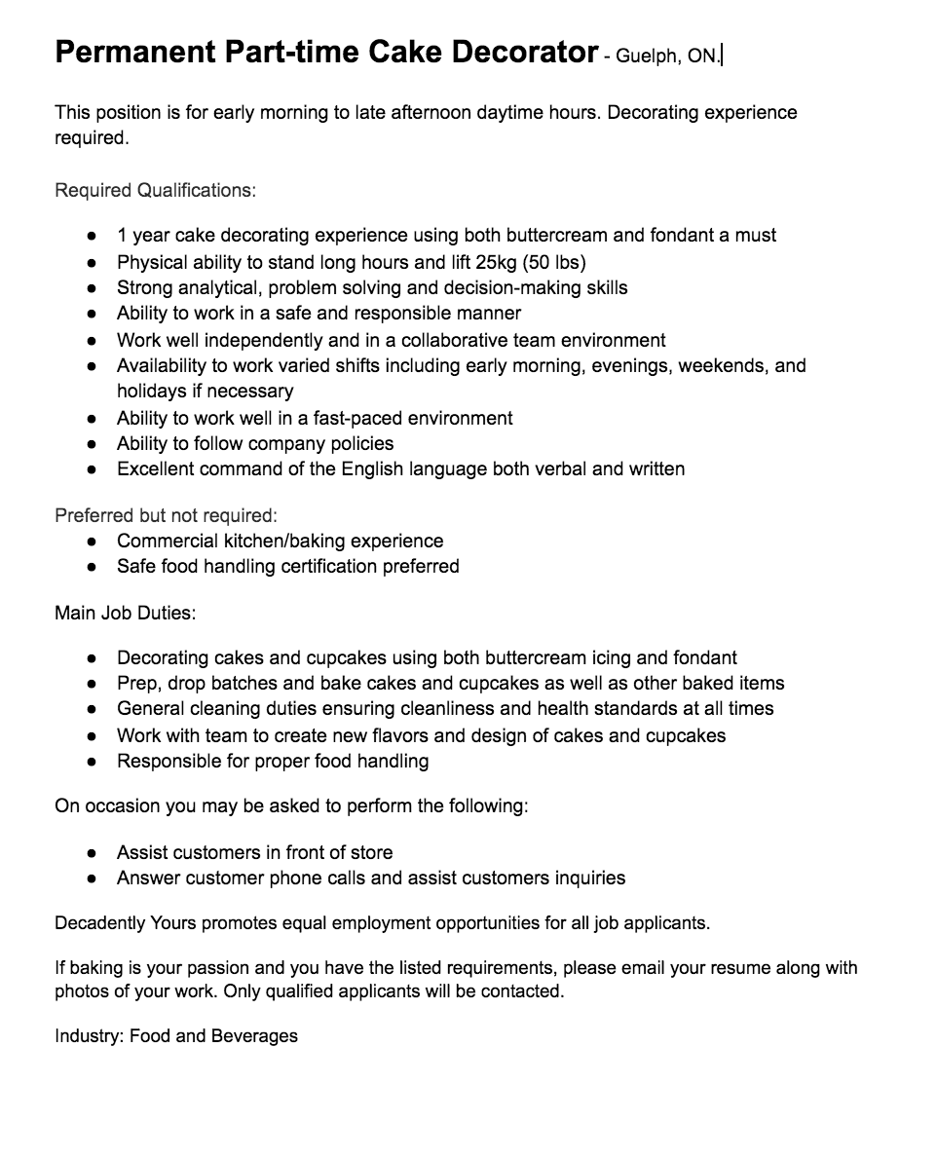
Recruiting

Slide 18
Recommendation
Automated Systems - Baking it (in the future)
Manual Working Systems - Excel Manual System
Social Media - Pinterest, & Hootsuite
Time Clock Applications - ATTO Team Activity
Recruiting - Future Posts on Linkedin, indeed & Monster

Slide 19
Thank You!
Centennial Consulting For

